Slide 1
Global Tuberculosis Trends and Insights
A Data-Driven Analysis of TB Incidence, Deaths, and Key Factors (2000-2020)
Presented by: Rebecca Garlena

Slide 2
Introduction to Tuberculosis
What is Tuberculosis?
A bacterial infection caused by Mycobacterium tuberculosis
Primarily affects the lungs but can affect other areas of the body
Global health concern with significant morbidity and mortality
Why This Analysis Matters?
Understanding trends in TB incidence and deaths can aid in public health planning
Highlights the impact of detection rates, treatment success, and co-infections with HIV

Slide 3
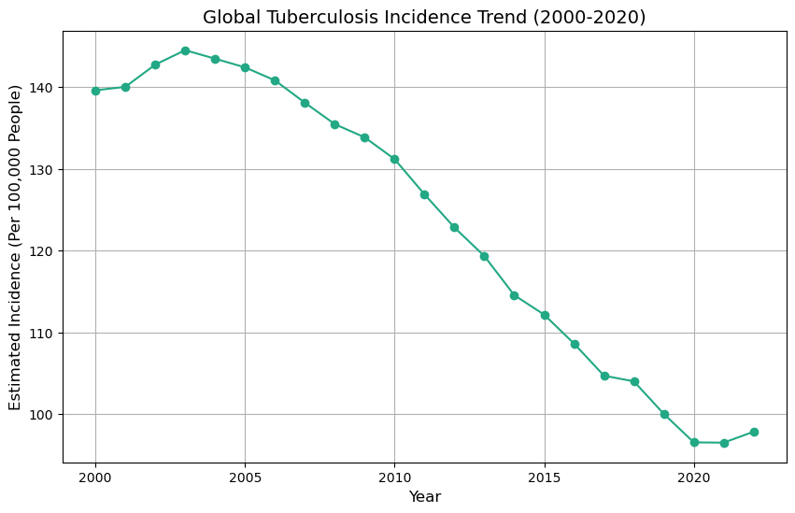
How has global TB incidence evolved over the past two decades?

Slide 4
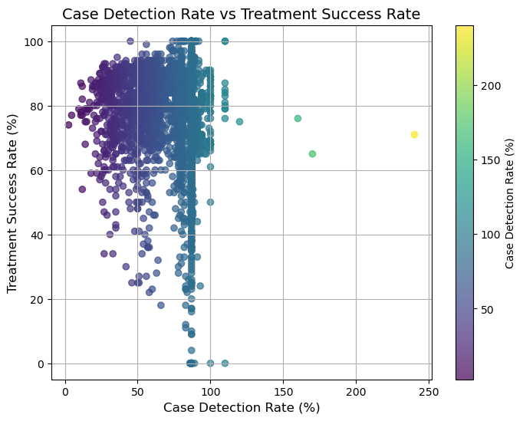
How does TB case detection relate to treatment success rate?

Slide 5
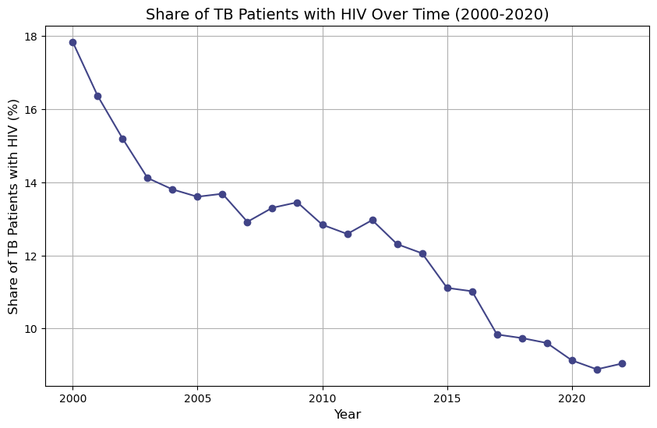
How has the share of TB patients co-infected with HIV changed over time?

Slide 6
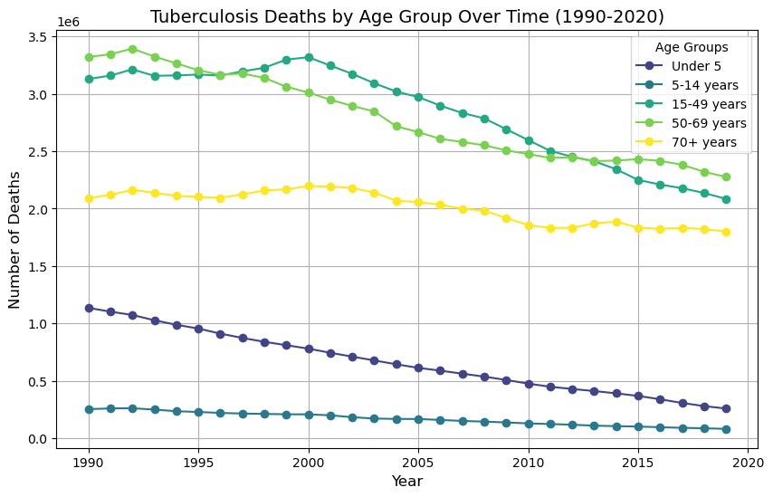
Which age groups are most affected by TB deaths?

Slide 7
Conclusions and Key Takeaways
Global TB incidence Decline
Steady reduction over the past two decades, reflecting the success of global health efforts
Detection Linked to Treatment Success
Higher case detection rates correlate with better treatment outcomes
HIV Co-infection Decreasing
Share of TB patients with HIV has declined significantly since 2000
TB Deaths Reduced Across All Ages
Major declines in TB deaths, especially in the working-age group, though older population remain at higher risk

Slide 8
Future Considerations
Focus on Older Populations
Target interventions for individuals 50+ who still face high TB mortality rates
Improve Detection and Treatment
Further increase case detection rates to continue improving treatment success, particularly in regions with lower coverage
Sustain Efforts on TB-HIV Co-infections
Maintain and expand programs that reduce the burden of HIV on TB outcomes
Address Emerging Drug Resistance
Monitor and combat drug-resistant TB strains to prevent a resurgence in incidence and mortality
Regional Disparities
Investigate variations in TB incidence and death rates across different regions to tailor interventions

